Slide 1
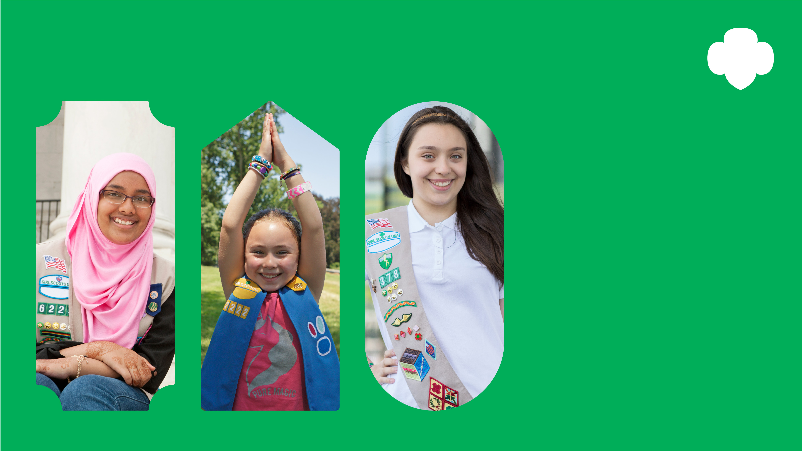
Girl Scouts Celebrate Faith
Celebrating the powerful ties between Girl Scouting and faith.
Honoring Girl Scouts and volunteers who make our world a better place.
Join us on [EVENT DATE, time].
Learn more at gswpa.org/faith.

Slide 2

Girl Scout Sunday
Celebrating the powerful ties between Girl Scouting and faith. Honoring Girl Scouts and volunteers who make our world a better place.
Join us on [EVENT DATE, time].
Learn more at gswpa.org/faith.

Slide 3
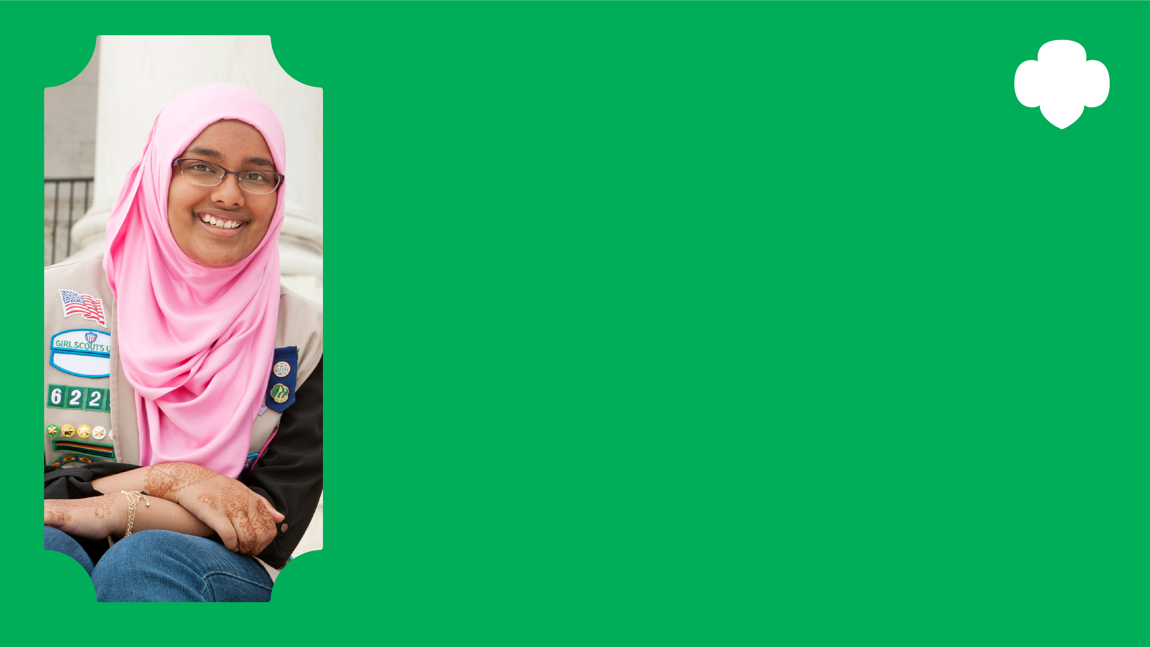
Girl Scout Jummah
Celebrating the powerful ties between Girl Scouting and faith. Honoring Girl Scouts and volunteers who make our world a better place.
Join us on [EVENT DATE, time].
Learn more at gswpa.org/faith.

Slide 4

Girl Scout Sabbath
Celebrating the powerful ties between Girl Scouting and faith. Honoring Girl Scouts and volunteers who make our world a better place.
Join us on [EVENT DATE, time].
Learn more at gswpa.org/faith.

